Slide 1
COMPUTER ARCHITECTURE CSE - 323
Lecture 3
A Top-Level View of Computer Function and Interconnection

Slide 2
Computer Components
Contemporary computer designs are based on concepts developed by John von Neumann at the Institute for Advanced Studies, Princeton
Referred to as the von Neumann architecture and is based on three key concepts:
Data and instructions are stored in a single read-write memory
The contents of this memory are addressable by location, without regard to the type of data contained there
Execution occurs in a sequential fashion (unless explicitly modified) from one instruction to the next
Hardwired program
The result of the process of connecting the various components in the desired configuration
Notes:
As discussed in Lecture 2, virtually all contemporary computer designs are based on concepts developed by John von Neumann at the Institute for Advanced Studies, Princeton. Such a design is referred to as the von Neumann architecture and is based on three key concepts:
• Data and instructions are stored in a single read–write memory.
• The contents of this memory are addressable by location, without regard to the type of data contained there.
• Execution occurs in a sequential fashion (unless explicitly modified) from one instruction to the next.
The reasoning behind these concepts was discussed in Chapter 2 but is worth summarizing here. There is a small set of basic logic components that can be combined in various ways to store binary data and perform arithmetic and logical operations on that data. If there is a particular computation to be performed, a configuration of logic components designed specifically for that computation could be constructed. We can think of the process of connecting the various components in the desired configuration as a form of programming. The resulting “program” is in the form of hardware and is termed as Hardwired program.

Slide 3
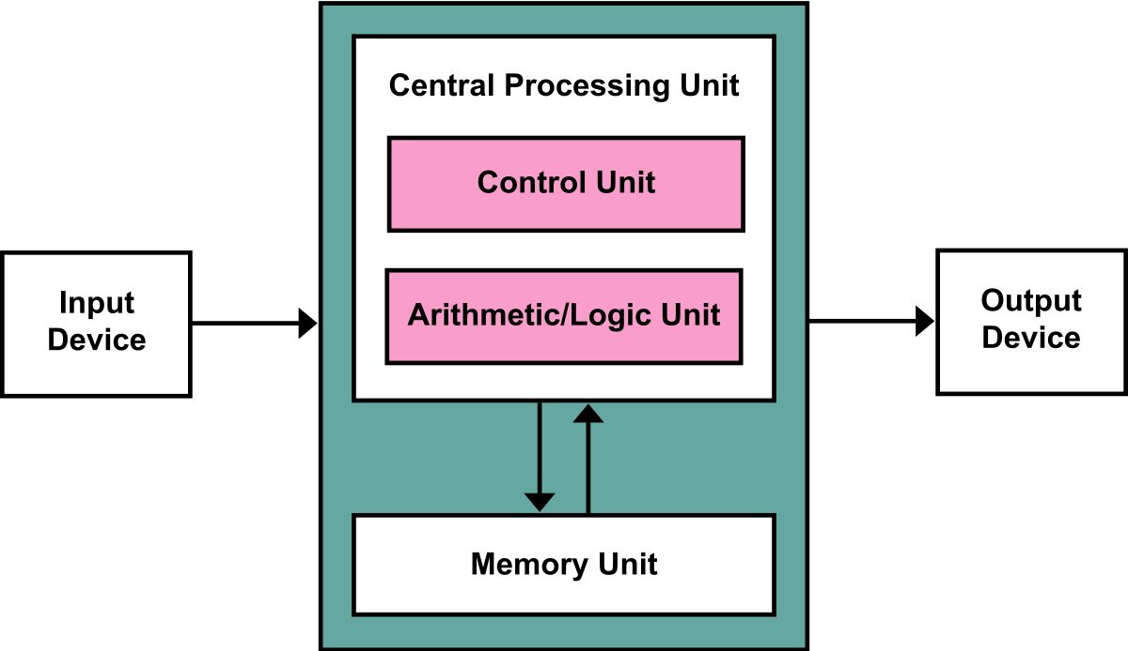
von Neumann architecture

Slide 4
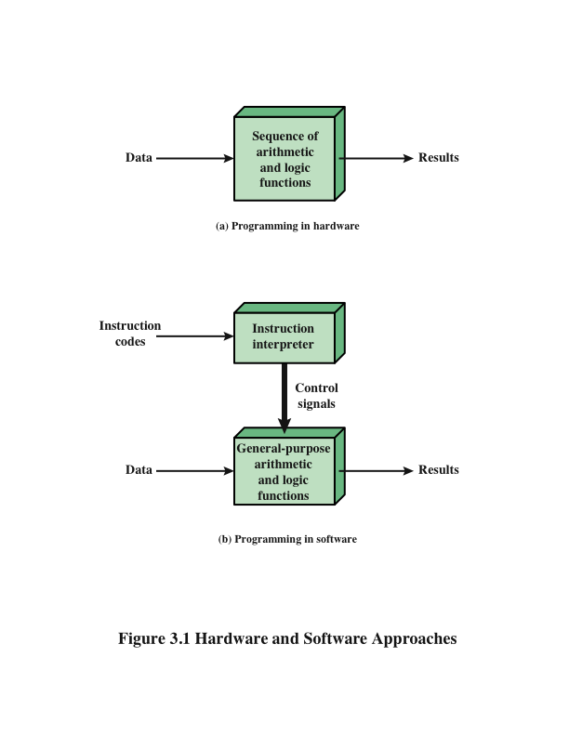
Hardware and Software Approaches
Hardwired machine
General Purpose Machine
Notes:
Now consider this alternative. Suppose we construct a general-purpose configuration of arithmetic and logic functions. This set of hardware will perform various functions on data depending on control signals applied to the hardware. In the original case of customized hardware, the system accepts data and produces results (Figure 3.1a). With general-purpose hardware, the system accepts data and control signals and produces results. Thus, instead of rewiring the hardware for each new program, the programmer merely needs to supply a new set of control signals. How shall control signals be supplied? The answer is simple but subtle. The entire program is actually a sequence of steps. At each step, some arithmetic or logical operation is performed on some data. For each step, a new set of control signals is needed. Let us provide a unique code for each possible set of control
signals, and let us add to the general-purpose hardware a segment that can accept a code and generate control signals (Figure 3.1b).

Slide 5
I/O Components
Software
A sequence of codes or instructions
Part of the hardware interprets each instruction and generates control signals
Provide a new sequence of codes for each new program instead of rewiring the hardware
Major components:
Means of reporting results
Output module
Contains basic components for accepting data and instructions and converting them into an internal form of signals usable by the system
Input module
I/O Components
Module of general-purpose arithmetic and logic functions
Instruction interpreter
CPU
Software
Notes:
Programming is now much easier. Instead of rewiring the hardware for each new program, all we need to do is provide a new sequence of codes. Each code is, in effect, an instruction, and part of the hardware interprets each instruction and generates control signals. To distinguish this new method of programming, a sequence of codes or instructions is called software.
Figure 3.1b indicates two major components of the system: an instruction interpreter and a module of general-purpose arithmetic and logic functions. These two constitute the CPU. Several other components are needed to yield a functioning computer. Data and instructions must be put into the system. For this we need some sort of input module. This module contains basic components for accepting data and instructions in some form and converting them into an internal form of signals usable by the system. A means of reporting results is needed, and this is in the form of an output module. Taken together, these are referred to as I/O components.

Slide 6
MEMORY
Memory address register (MAR)
Specifies the address in memory for the next read or write
Memory buffer register (MBR)
Contains the data to be written into memory or receives the data read from memory
I/O address register (I/OAR)
Specifies a particular I/O device
I/O buffer register (I/OBR)
Used for the exchange of data between an I/O module and the CPU
MAR
MBR
Notes:
One more component is needed. An input device will bring instructions and data in sequentially. But a program is not invariably executed sequentially; it may jump around (e.g., the IAS jump instruction). Similarly, operations on data may require access to more than just one element at a time in a predetermined sequence. Thus, there must be a place to store temporarily both instructions and data. That module is called memory, or main memory, to distinguish it from external storage or peripheral devices. Von Neumann pointed out that the same memory could be used to store both instructions and data.
The CPU exchanges data with memory. For this purpose, it typically makes use of two internal (to the CPU) registers: a memory address register (MAR), which specifies the address in memory for the next read or write, and a memory buffer register (MBR), which contains the data to be written into memory or receives the data read from memory. Similarly, an I/O address register (I/OAR) specifies a particular I/O device. An I/O buffer (I/OBR) register is used for the exchange of data between an I/O module and the CPU.

Slide 7
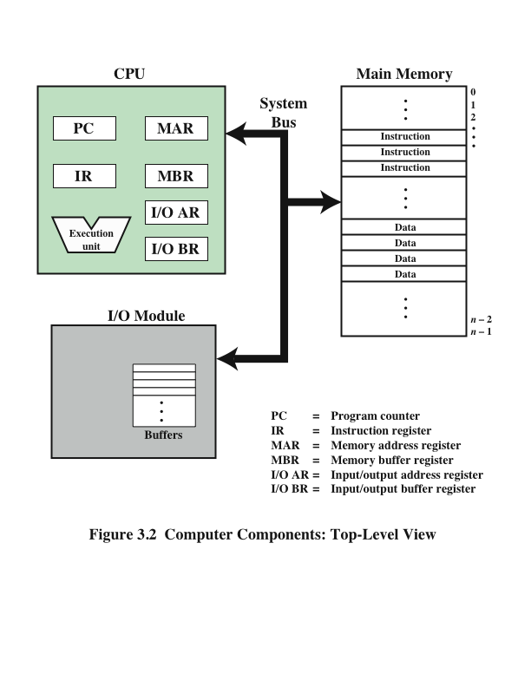
Computer Components: Top Level View
Notes:
Figure 3.2 illustrates these top-level components and suggests the interactions among them.
A memory module consists of a set of locations, defined by sequentially numbered addresses. Each location contains a binary number that can be interpreted as either an instruction or data. An I/O module transfers data from external devices
to CPU and memory, and vice versa. It contains internal buffers for temporarily holding these data until they can be sent on.

Slide 8
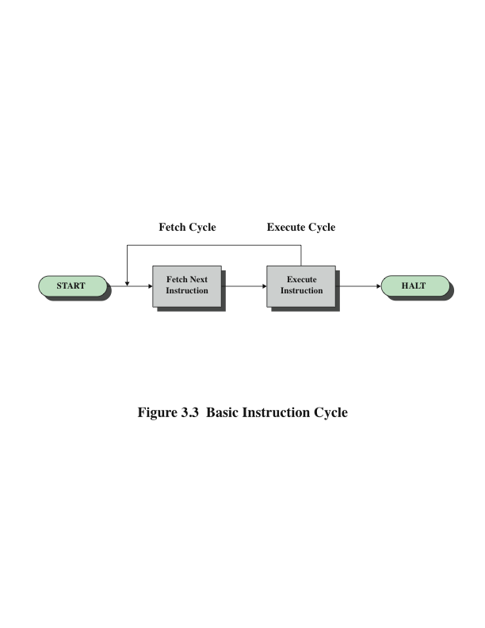
Basic Instruction Cycle
Notes:
In its simplest form, instruction processing
consists of two steps: The processor reads (fetches) instructions from memory one at a time and executes each instruction. Program execution consists of repeating the process of instruction fetch and instruction execution. The instruction execution may involve several operations and depends on the nature of the instruction.
The processing required for a single instruction is called an instruction cycle. Using the simplified two-step description given previously, the instruction cycle is depicted in Figure 3.3. The two steps are referred to as the fetch cycle and the execute
cycle. Program execution halts only if the machine is turned off, some sort of unrecoverable error occurs, or a program instruction that halts the computer is encountered.

Slide 9
Fetch Cycle
At the beginning of each instruction cycle the processor fetches an instruction from memory
The program counter (PC) holds the address of the instruction to be fetched next
The processor increments the PC after each instruction fetch so that it will fetch the next instruction in sequence
The fetched instruction is loaded into the instruction register (IR)
The processor interprets the instruction and performs the required action
Notes:
At the beginning of each instruction cycle, the processor fetches an instruction from memory. In a typical processor, a register called the program counter (PC) holds the address of the instruction to be fetched next. Unless told otherwise, the processor always increments the PC after each instruction fetch so that it will fetch the next instruction in sequence (i.e., the instruction located at the next higher memory address). So, for example, consider a computer in which each instruction occupies one 16-bit word of memory. Assume that the program counter is set to memory location 300, where the location address refers to a 16-bit word. The processor will next fetch the instruction at location 300. On succeeding instruction cycles, it will fetch instructions from locations 301, 302, 303, and so on. This sequence may be altered, as explained presently.
The fetched instruction is loaded into a register in the processor known as the instruction register (IR). The instruction contains bits that specify the action the processor is to take. The processor interprets the instruction and performs the required action.

Slide 10
Action Categories
Processor-memory
Data transferred from processor to memory or from memory to processor
Processor-I/O
Data transferred to or from a peripheral device by transferring between the processor and an I/O module
Data processing
The processor may perform some arithmetic or logic operation on data
Control
An instruction may specify that the sequence of execution be altered
Notes:
In general, these actions fall into four categories:
Processor-memory: Data may be transferred from processor to memory or from memory to processor.
• Processor-I/O: Data may be transferred to or from a peripheral device by transferring between the processor and an I/O module.
• Data processing: The processor may perform some arithmetic or logic operation on data.
• Control: An instruction may specify that the sequence of execution be altered.
For example, the processor may fetch an instruction from location 149, which specifies that the next instruction be from location 182. The processor will remember this fact by setting the program counter to 182. Thus, on the next fetch cycle, the instruction will be fetched from location 182 rather than 150.
An instruction’s execution may involve a combination of these actions.

Slide 11
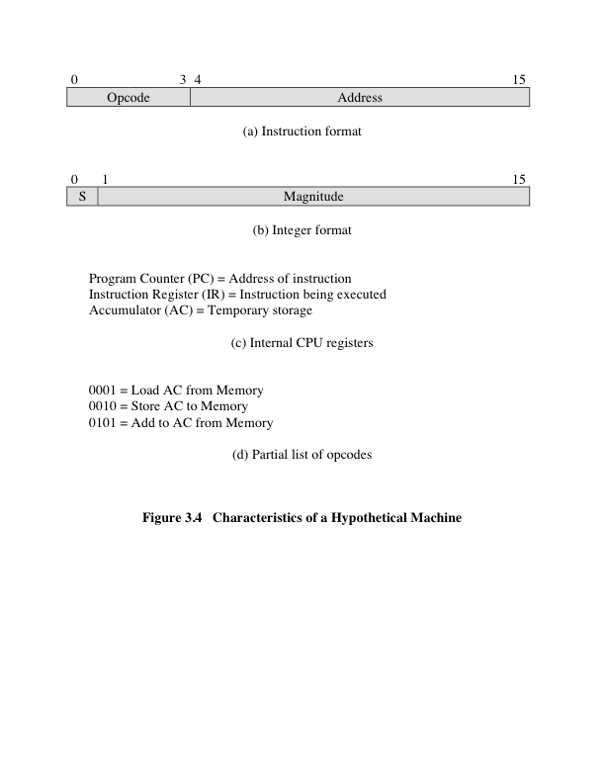
Notes:
Consider a simple example using a hypothetical machine that includes the characteristics listed in Figure 3.4. The processor contains a single data register, called an accumulator (AC). Both instructions and data are 16 bits long. Thus, it is convenient to organize memory using 16-bit words. The instruction format provides 4 bits for the opcode, so that there can be as many as 2⁴ = 16 different opcodes, and up to 2¹² = 4096 (4K) words of memory can be directly addressed.

Slide 12
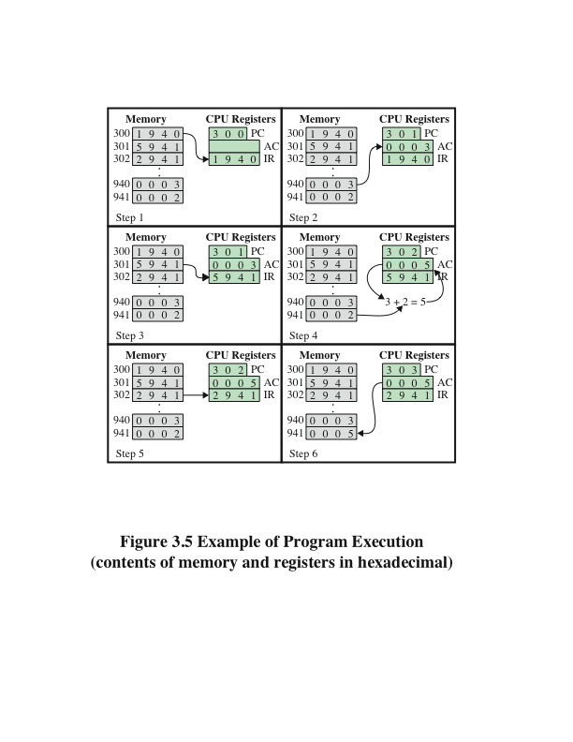
Example of Program Execution
On EXAM
Notes:
Figure 3.5 illustrates a partial program execution, showing the relevant portions of memory and processor registers. The program fragment shown adds the contents of the memory word at address 940 to the contents of the memory word at address 941 and stores the result in the latter location. Three instructions, which can be described as three fetch and three execute cycles, are required:
1. The PC contains 300, the address of the first instruction. This instruction (the value 1940 in hexadecimal) is loaded into the instruction register IR, and the PC is incremented. Note that this process involves the use of a memory address register and a memory buffer register. For simplicity, these intermediate registers are ignored.
2. The first 4 bits (first hexadecimal digit) in the IR indicate that the AC is to be loaded. The remaining 12 bits (three hexadecimal digits) specify the address (940) from which data are to be loaded.
3. The next instruction (5941) is fetched from location 301, and the PC is incremented.
4. The old contents of the AC and the contents of location 941 are added, and the result is stored in the AC.
5. The next instruction (2941) is fetched from location 302, and the PC is incremented.
6. The contents of the AC are stored in location 941.
In this example, three instruction cycles, each consisting of a fetch cycle and an execute cycle, are needed to add the contents of location 940 to the contents of 941. With a more complex set of instructions, fewer cycles would be needed. Some older processors, for example, included instructions that contain more than one memory address. Thus, the execution cycle for a particular instruction on such processors could involve more than one reference to memory. Also, instead of memory references, an instruction may specify an I/O operation.

Slide 13
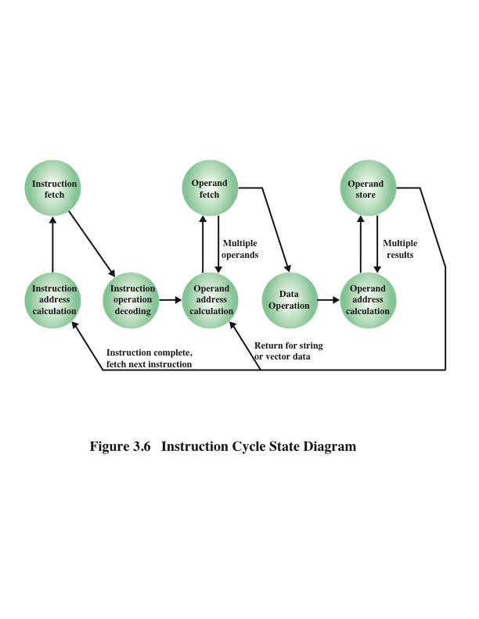
Instruction Cycle State Diagram DISCUSSED
Notes:
The execution cycle for a particular instruction may involve more than one reference to memory. Also, instead of memory references, an instruction may specify an I/O operation. With these additional considerations in mind, Figure 3.6 provides a more detailed look at the basic instruction cycle of Figure 3.3. The figure is in the form of a state diagram.
For any given instruction cycle, some states may be null and others may be visited more than once. The states can be described as follows:
• Instruction address calculation (iac): Determine the address of the next instruction to be executed. Usually, this involves adding a fixed number to the address of the previous instruction. For example, if each instruction is 16 bits long and memory is organized into 16-bit words, then add 1 to the previous address. If, instead, memory is organized as individually addressable 8-bit
bytes, then add 2 to the previous address.
• Instruction fetch (if): Read instruction from its memory location into the processor.
• Instruction operation decoding (iod): Analyze instruction to determine type of operation to be performed and operand(s) to be used.
• Operand address calculation (oac): If the operation involves reference to an operand in memory or available via I/O, then determine the address of the operand.
• Operand fetch (of): Fetch the operand from memory or read it in from I/O.
• Data operation (do): Perform the operation indicated in the instruction.
• Operand store (os): Write the result into memory or out to I/O.
States in the upper part of Figure 3.6 involve an exchange between the processor and either memory or an I/O module. States in the lower part of the diagram involve only internal processor operations. The oac state appears twice, because an instruction may involve a read, a write, or both. However, the action performed during that state is fundamentally the same in both cases, and so only a single state identifier is needed.
Also note that the diagram allows for multiple operands and multiple results, because some instructions on some machines require this. For example, the PDP-11 instruction ADD A,B results in the following sequence of states: iac, if, iod, oac, of, oac, of, do, oac, os.
Finally, on some machines, a single instruction can specify an operation to be performed on a vector (one-dimensional array) of numbers or a string (one-dimensional array) of characters. As Figure 3.6 indicates, this would involve repetitive operand fetch
and/or store operations.

Slide 14
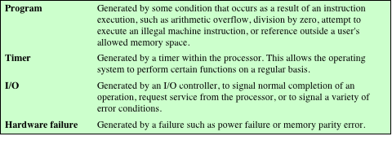
Classes of Interrupts
Notes:
Virtually all computers provide a mechanism by which other modules (I/O, memory) may interrupt the normal processing of the processor. Table 3.1 lists the most common classes of interrupts. The specific nature of these interrupts is examined
later in this book, especially in Chapters 7 and 14. However, we need to introduce the concept now to understand more clearly the nature of the instruction cycle and the implications of interrupts on the interconnection structure.

Slide 15
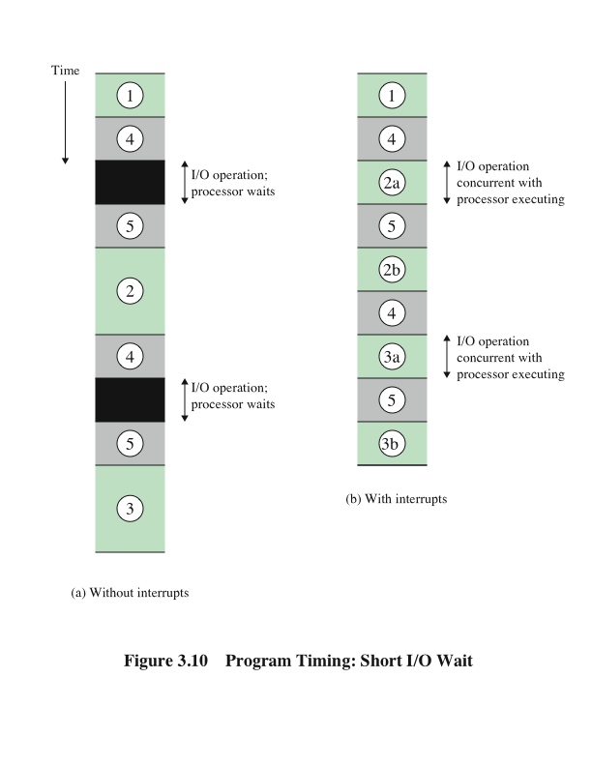
Program Timing: Short I/O Wait DISCUSSED
Notes:
To appreciate the gain in efficiency, consider Figure 3.10, which is a timing diagram based on the flow of control in Figures 3.7a and 3.7b. In this figure, user program code segments are shaded green, and I/O program code segments are shaded gray. Figure 3.10a shows the case in which interrupts are not used. The processor must wait while an I/O operation is performed.
Figures 3.7b and 3.10b assume that the time required for the I/O operation is relatively short: less than the time to complete the execution of instructions between write operations in the user program. In this case, the segment of code labeled code segment
2 is interrupted. A portion of the code (2a) executes (while the I/O operation is performed) and then the interrupt occurs (upon the completion of the I/O operation). After the interrupt is serviced, execution resumes with the remainder of code segment 2 (2b).

Slide 16
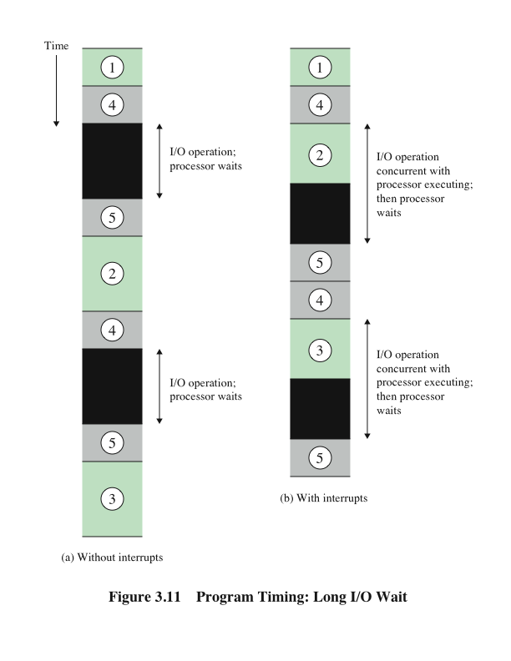
Program Timing: Long I/O Wait DISCUSSED
Notes:
The more typical case, especially for a slow device such as a printer, is that the I/O operation will take much more time than executing a sequence of user instructions. Figure 3.7c indicates this state of affairs. In this case, the user program reaches the second WRITE call before the I/O operation spawned by the first call is complete. The result is that the user program is hung up at that point. When the preceding I/O operation is completed, this new WRITE call may be processed, and a new I/O operation may be started. Figure 3.11 shows the timing for this situation with and without the use of interrupts. We can see that there is still a gain in efficiency because part of the time during which the I/O operation is under way overlaps with the execution of user instructions.

Slide 17
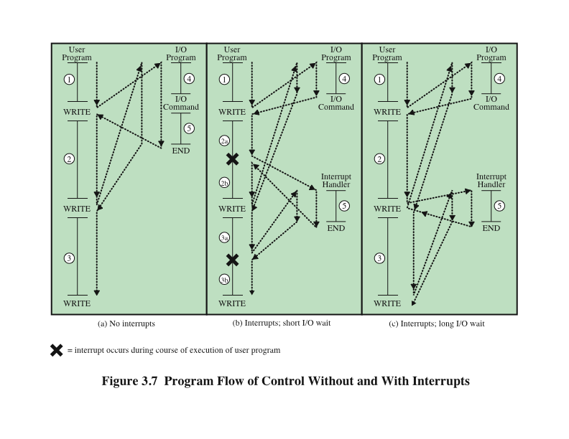
Program Flow Control
NO Details
Notes:
Interrupts are provided primarily as a way to improve processing efficiency. For example, most external devices are much slower than the processor. Suppose that the processor is transferring data to a printer using the instruction cycle scheme of Figure 3.3. After each write operation, the processor must pause and remain idle until the printer catches up. The length of this pause may be on the order of many hundreds or even thousands of instruction cycles that do not involve memory. Clearly, this is a very wasteful use of the processor.
Figure 3.7a illustrates this state of affairs. The user program performs a series of WRITE calls interleaved with processing. Code segments 1, 2, and 3 refer to sequences of instructions that do not involve I/O. The WRITE calls are to an I/O program that is a system utility and that will perform the actual I/O operation. The I/O program consists of three sections:
• A sequence of instructions, labeled 4 in the figure, to prepare for the actual I/O operation. This may include copying the data to be output into a special buffer and preparing the parameters for a device command.
• The actual I/O command. Without the use of interrupts, once this command is issued, the program must wait for the I/O device to perform the requested function
(or periodically poll the device). The program might wait by simply repeatedly performing a test operation to determine if the I/O operation is done.
• A sequence of instructions, labeled 5 in the figure, to complete the operation. This may include setting a flag indicating the success or failure of the operation.
Because the I/O operation may take a relatively long time to complete, the I/O program is hung up waiting for the operation to complete; hence, the user program is stopped at the point of the WRITE call for some considerable period of time.
With interrupts, the processor can be engaged in executing other instructions while an I/O operation is in progress. Consider the flow of control in Figure 3.7b. As before, the user program reaches a point at which it makes a system call in the form of a WRITE call. The I/O program that is invoked in this case consists only of the preparation code and the actual I/O command. After these few instructions have been executed, control returns to the user program. Meanwhile, the external device is busy accepting data from computer memory and printing it. This I/O operation is conducted concurrently with the execution of instructions in the user program.
When the external device becomes ready to be serviced—that is, when it is ready to accept more data from the processor—the I/O module for that external device sends an interrupt request signal to the processor. The processor responds by suspending operation of the current program, branching off to a program to service that particular I/O device, known as an interrupt handler, and resuming the original execution after the device is serviced. The points at which such interrupts occur are indicated by an asterisk in Figure 3.7b.
Let us try to clarify what is happening in Figure 3.7. We have a user program that contains two WRITE commands. There is a segment of code at the beginning, then one WRITE command, then a second segment of code, then a second WRITE command, then a third and final segment of code. The WRITE command invokes the I/O program provided by the OS. Similarly, the I/O program consists of a segment of code, followed by an I/O command, followed by another segment of code. The I/O command invokes a hardware I/O operation.

Slide 18
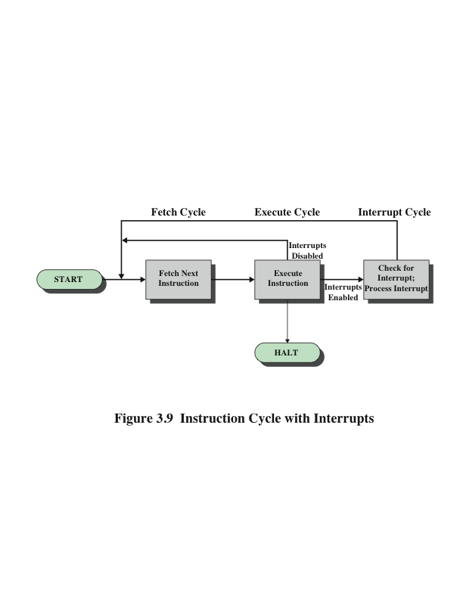
Instruction Cycle With Interrupts
Notes:
To accommodate interrupts, an interrupt cycle is added to the instruction cycle, as shown in Figure 3.9. In the interrupt cycle, the processor checks to see if any interrupts have occurred, indicated by the presence of an interrupt signal. If no interrupts are pending, the processor proceeds to the fetch cycle and fetches the next instruction of the current program. If an interrupt is pending, the processor does the following:
• It suspends execution of the current program being executed and saves its context. This means saving the address of the next instruction to be executed (current contents of the program counter) and any other data relevant to the processor’s current activity.
• It sets the program counter to the starting address of an interrupt handler routine.
The processor now proceeds to the fetch cycle and fetches the first instruction in the interrupt handler program, which will service the interrupt. The interrupt handler program is generally part of the operating system. Typically, this program determines the nature of the interrupt and performs whatever actions are needed. In the example we have been using, the handler determines which I/O module generated the interrupt and may branch to a program that will write more data out to that I/O module. When the interrupt handler routine is completed, the processor can resume execution of the user program at the point of interruption.
It is clear that there is some overhead involved in this process. Extra instructions must be executed (in the interrupt handler) to determine the nature of the interrupt and to decide on the appropriate action. Nevertheless, because of the relatively large
amount of time that would be wasted by simply waiting on an I/O operation, the processor can be employed much more efficiently with the use of interrupts.

Slide 19
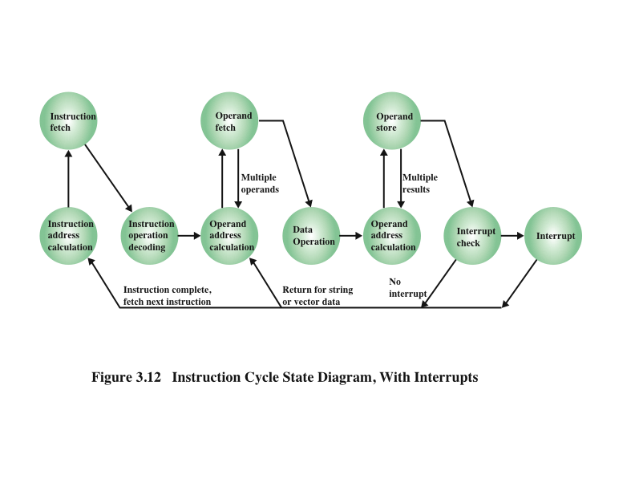
Instruction Cycle State Diagram With Interrupts
Notes:
Figure 3.12 shows a revised instruction cycle state diagram that includes interrupt cycle processing.

Slide 20
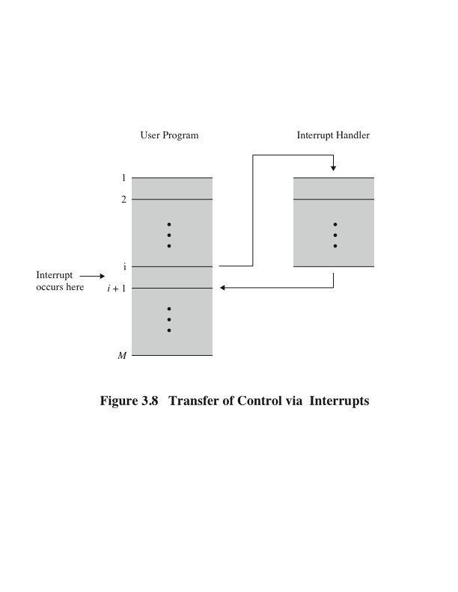
Transfer of Control via Interrupts
Notes:
From the point of view of the user program, an interrupt is just that: an interruption of the normal sequence of execution. When the interrupt processing is completed, execution resumes (Figure 3.8). Thus, the user program does not have to contain any special code to accommodate interrupts; the processor and the operating system are responsible for suspending the user program and then resuming it at the same point.

Slide 21
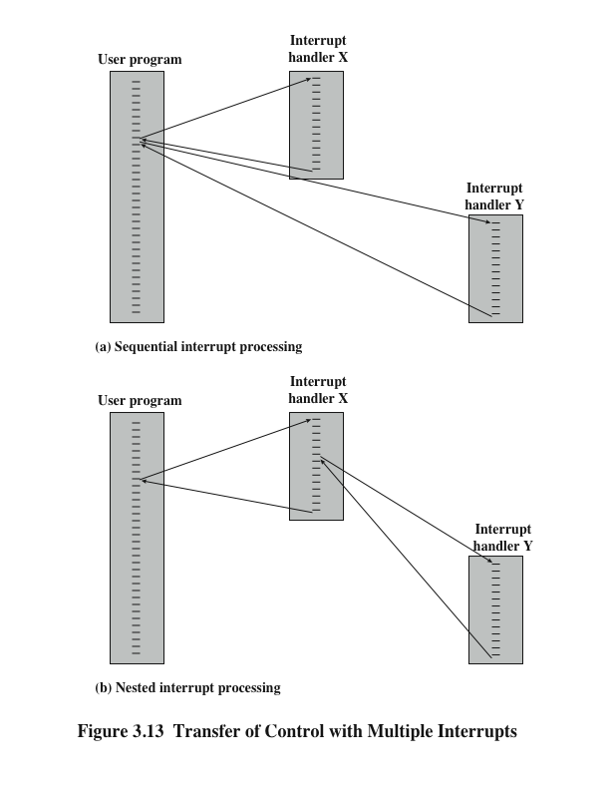
Multiple Interrupts
Detail below
Transfer of
Control
Detail next slide
Notes:
Two approaches can be taken to dealing with multiple interrupts. The first is to disable interrupts while an interrupt is being processed. A disabled interrupt simply means that the processor can and will ignore that interrupt request signal. If an interrupt
occurs during this time, it generally remains pending and will be checked by the processor after the processor has enabled interrupts. Thus, when a user program is executing and an interrupt occurs, interrupts are disabled immediately. After the interrupt handler routine completes, interrupts are enabled before resuming the user program, and the processor checks to see if additional interrupts have occurred. This approach is nice and simple, as interrupts are handled in strict sequential order (Figure 3.13a).
The drawback to the preceding approach is that it does not take into account relative priority or time-critical needs. For example, when input arrives from the communications line, it may need to be absorbed rapidly to make room for more input. If the first batch of input has not been processed before the second batch arrives, data may be lost.
A second approach is to define priorities for interrupts and to allow an interrupt of higher priority to cause a lower-priority interrupt handler to be itself interrupted (Figure 3.13b).

Slide 22
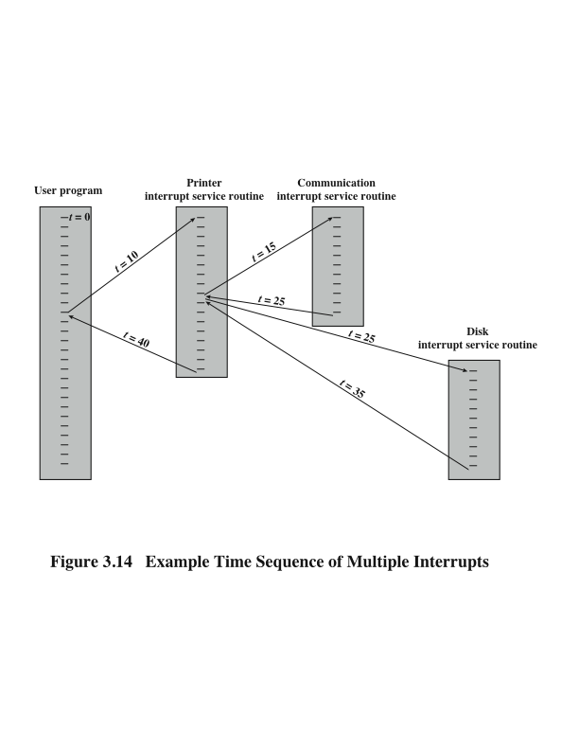
Time Sequence of Multiple Interrupts
Example
Notes:
As an example of this second approach, consider a system with three I/O devices: a printer, a disk, and a communications line, with
increasing priorities of 2, 4, and 5, respectively. Figure 3.14 illustrates a possible sequence. A user program begins at t = 0. At t = 10, a printer interrupt occurs; user information is placed on the system stack and execution continues at the printer interrupt service routine (ISR). While this routine is still executing, at t = 15, a communications interrupt occurs. Because the communications line has higher priority than the printer, the interrupt is honored. The printer ISR is interrupted, its state is pushed onto the stack, and execution continues at the communications ISR. While this routine is executing, a disk interrupt occurs (t = 20). Because this interrupt is of lower priority, it is simply held, and the communications ISR runs to completion.
When the communications ISR is complete (t = 25), the previous processor state is restored, which is the execution of the printer ISR. However, before even a single instruction in that routine can be executed, the processor honors the higher priority
disk interrupt and control transfers to the disk ISR. Only when that routine is complete (t = 35) is the printer ISR resumed. When that routine completes (t = 40), control finally returns to the user program.

Slide 23
I/O Function
I/O module can exchange data directly with the processor
Processor can read data from or write data to an I/O module
Processor identifies a specific device that is controlled by a particular I/O module
I/O instructions rather than memory referencing instructions
In some cases it is desirable to allow I/O exchanges to occur directly with memory
The processor grants to an I/O module the authority to read from or write to memory so that the I/O memory transfer can occur without tying up the processor
The I/O module issues read or write commands to memory relieving the processor of responsibility for the exchange
This operation is known as direct memory access (DMA)
Notes:
An I/O module (e.g., a disk controller) can exchange data directly with the processor. Just as the processor can initiate a read or write with memory, designating the address of a specific location, the processor can also read data from or write data to an I/O module. In this latter case, the processor identifies a specific device that is controlled by a particular I/O module. Thus, an instruction sequence similar in form to that of Figure 3.5 could occur, with I/O instructions rather than memory-referencing
instructions.
In some cases, it is desirable to allow I/O exchanges to occur directly with memory. In such a case, the processor grants to an I/O module the authority to read from or write to memory, so that the I/O-memory transfer can occur without tying up the processor. During such a transfer, the I/O module issues read or write commands to memory, relieving the processor of responsibility for the exchange. This operation is known as direct memory access (DMA) and is examined in Chapter 7.

Slide 24
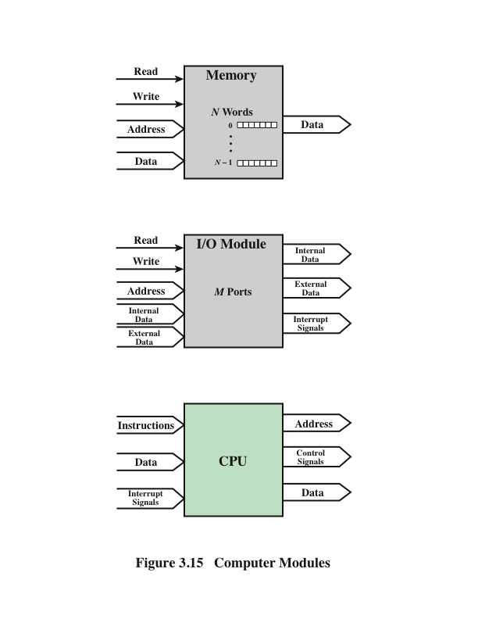
Computer Modules
Notes:
A computer consists of a set of components or modules of three basic types (processor, memory, I/O) that communicate with each other. In effect, a computer is a network of basic modules. Thus, there must be paths for connecting the modules.
The collection of paths connecting the various modules is called the interconnection structure. The design of this structure will depend on the exchanges that must be made among modules.
Figure 3.15 suggests the types of exchanges that are needed by indicating the major forms of input and output for each module type:
• Memory: Typically, a memory module will consist of N words of equal length. Each word is assigned a unique numerical address (0, 1, …, N - 1). A word of data can be read from or written into the memory. The nature of the operation is indicated by read and write control signals. The location for the operation is specified by an address.
• I/O module: From an internal (to the computer system) point of view, I/O is functionally similar to memory. There are two operations, read and write. Further, an I/O module may control more than one external device. We can refer to each of the interfaces to an external device as a port and give each a unique address (e.g., 0, 1, …, M - 1). In addition, there are external data
paths for the input and output of data with an external device. Finally, an I/O module may be able to send interrupt signals to the processor.
• Processor: The processor reads in instructions and data, writes out data after processing, and uses control signals to control the overall operation of the system. It also receives interrupt signals.

Slide 25
The interconnection structure must support the following types of transfers:
Memory to processor
Processor reads an instruction or a unit of data from memory
Processor to memory
Processor writes a unit of data to memory
I/O to processor
Processor reads data from an I/O device via an I/O module
Processor to I/O
Processor sends data to the I/O device
I/O to or from memory
An I/O module is allowed to exchange data directly with memory without going through the processor using direct memory access
Notes:
The preceding list defines the data to be exchanged. The interconnection structure must support the following types of transfers:
• Memory to processor: The processor reads an instruction or a unit of data from memory.
• Processor to memory: The processor writes a unit of data to memory.
• I/O to processor: The processor reads data from an I/O device via an I/O module.
• Processor to I/O: The processor sends data to the I/O device.
• I/O to or from memory: For these two cases, an I/O module is allowed to exchange data directly with memory, without going through the processor, using direct memory access.
Over the years, a number of interconnection structures have been tried. By far the most common are (1) the bus and various multiple-bus structures, and (2) point-to-point interconnection structures with packetized data transfer. We devote the remainder of this chapter for a discussion of these structures.

Slide 26
Bus Inter connection
A communication pathway connecting two or more devices
Key characteristic is that it is a shared transmission medium
Signals transmitted by any one device are available for reception by all other devices attached to the bus
If two devices transmit during the same time period their signals will overlap and become garbled
Typically consists of multiple communication lines
Each line is capable of transmitting signals representing binary 1 and binary 0
Computer systems contain a number of different buses that provide pathways between components at various levels of the computer system hierarchy
System bus
A bus that connects major computer components (processor, memory, I/O)
The most common computer interconnection structures are based on the use of one or more system buses
Notes:
A bus is a communication pathway connecting two or more devices. A key characteristic of a bus is that it is a shared transmission medium. Multiple devices connect to the bus, and a signal transmitted by any one device is available for reception by
all other devices attached to the bus. If two devices transmit during the same time period, their signals will overlap and become garbled. Thus, only one device at a time can successfully transmit.
Typically, a bus consists of multiple communication pathways, or lines. Each line is capable of transmitting signals representing binary 1 and binary 0. Over time, a sequence of binary digits can be transmitted across a single line. Taken together, several lines of a bus can be used to transmit binary digits simultaneously (in parallel). For example, an 8-bit unit of data can be transmitted over eight bus lines.
Computer systems contain a number of different buses that provide pathways between components at various levels of the computer system hierarchy. A bus that connects major computer components (processor, memory, I/O) is called a system
bus. The most common computer interconnection structures are based on the use of one or more system buses.

Slide 27
Data Bus
Data lines that provide a path for moving data among system modules
May consist of 32, 64, 128, or more separate lines
The number of lines is referred to as the width of the data bus
The number of lines determines how many bits can be transferred at a time
The width of the data bus
is a key factor in
determining overall
system performance
Notes:
A system bus consists, typically, of from about fifty to hundreds of separate lines. The data lines provide a path for moving data among system modules. These lines, collectively, are called the data bus. The data bus may consist of 32, 64, 128, or even more separate lines, the number of lines being referred to as the width of the data bus. Because each line can carry only 1 bit at a time, the number of lines determines how many bits can be transferred at a time. The width of the data bus is a key factor in determining overall system performance. For example, if the data bus is 32 bits wide and each instruction is 64 bits long, then the processor must access the memory module twice during each instruction cycle.

Slide 28
Address Bus Control Bus
Used to designate the source or destination of the data on the data bus
If the processor wishes to read a word of data from memory it puts the address of the desired word on the address lines
Width determines the maximum possible memory capacity of the system
Also used to address I/O ports
The higher order bits are used to select a particular module on the bus and the lower order bits select a memory location or I/O port within the module
Used to control the access and the use of the data and address lines
Because the data and address lines are shared by all components there must be a means of controlling their use
Control signals transmit both command and timing information among system modules
Timing signals indicate the validity of data and address information
Command signals specify operations to be performed
Notes:
The address lines are used to designate the source or destination of the data on the data bus. For example, if the processor wishes to read a word (8, 16, or 32 bits) of data from memory, it puts the address of the desired word on the address lines. Clearly, the width of the address bus determines the maximum possible memory capacity of the system. Furthermore, the address lines are generally also used to address I/O ports. Typically, the higher-order bits are used to select a particular module on the bus, and the lower-order bits select a memory location or I/O port within the module. For example, on an 8-bit address bus, address 01111111 and below might reference locations in a memory module (module 0) with 128 words of memory, and address 10000000 and above refer to devices attached to an I/O module (module 1).
The control lines are used to control the access to and the use of the data and address lines. Because the data and address lines are shared by all components, there must be a means of controlling their use. Control signals transmit both command and timing information among system modules. Timing signals indicate the validity of data and address information. Command signals specify operations to be performed. Typical control lines include:
• Memory write: causes data on the bus to be written into the addressed location
• Memory read: causes data from the addressed location to be placed on the bus
• I/O write: causes data on the bus to be output to the addressed I/O port
• I/O read: causes data from the addressed I/O port to be placed on the bus
• Transfer ACK: indicates that data have been accepted from or placed on the bus
• Bus request: indicates that a module needs to gain control of the bus
• Bus grant: indicates that a requesting module has been granted control of the bus
• Interrupt request: indicates that an interrupt is pending
• Interrupt ACK: acknowledges that the pending interrupt has been recognized
• Clock: is used to synchronize operations
• Reset: initializes all modules

Slide 29
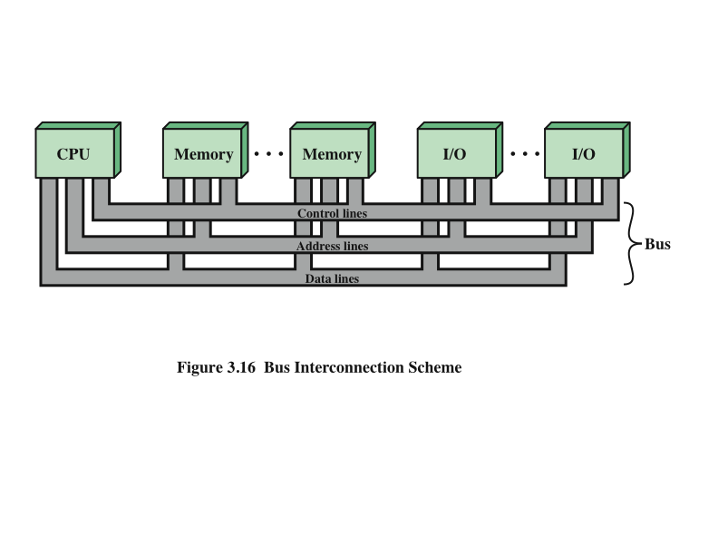
Bus Interconnection Scheme
Notes:
The operation of the bus is as follows. If one module wishes to send data to another, it must do two things: (1) obtain the use of the bus, and (2) transfer data via the bus. If one module wishes to request data from another module, it must (1) obtain the use of the bus, and (2) transfer a request to the other module over the appropriate control and address lines. It must then wait for that second module to send the data.

Slide 30
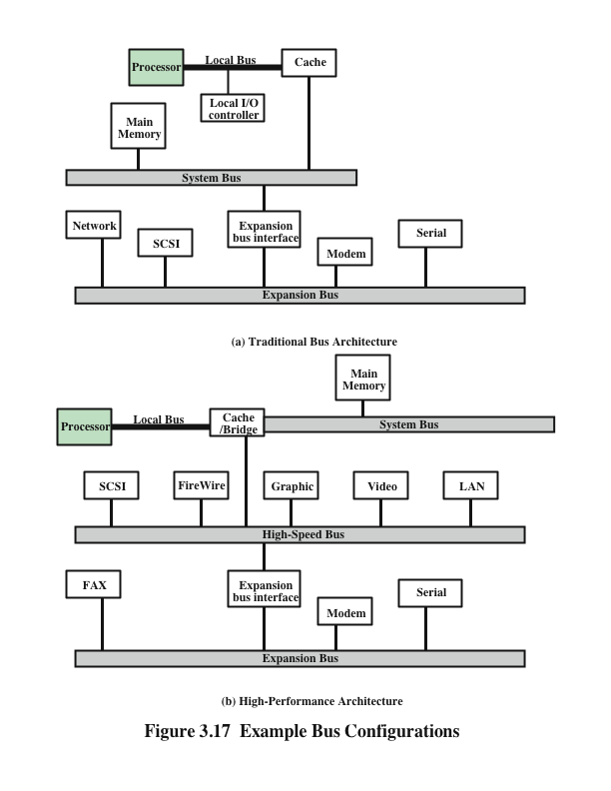
Bus
Configurations
Notes:
If a great number of devices are connected to the bus, performance will suffer. There are two main causes:
1. In general, the more devices attached to the bus, the greater the bus length and hence the greater the propagation delay. This delay determines the time it takes for devices to coordinate the use of the bus. When control of the bus passes from one device to another frequently, these propagation delays can noticeably affect performance.
2. The bus may become a bottleneck as the aggregate data transfer demand approaches the capacity of the bus. This problem can be countered to some extent by increasing the data rate that the bus can carry and by using wider buses (e.g., increasing the data bus from 32 to 64 bits). However, because the data rates generated by attached devices (e.g., graphics and video controllers,
network interfaces) are growing rapidly, this is a race that a single bus is ultimately destined to lose.
Accordingly, most bus-based computer systems use multiple buses, generally laid out in a hierarchy. A typical traditional structure is shown in Figure 3.17a. There is a local bus that connects the processor to a cache memory and that may support one or more local devices. The cache memory controller connects the cache not only to this local bus, but to a system bus to which are attached all of the main memory modules. In contemporary systems, the cache is in the same chip as the processor, and so an external bus or other interconnect scheme is not needed, although there may also be an external cache. As will be discussed in Chapter 4, the use of a cache structure insulates the processor from a requirement to access main memory frequently. Hence, main memory can be moved off of the local bus onto a system bus. In this way, I/O transfers to and from the main memory across the system bus do not interfere with the processor’s activity.
It is possible to connect I/O controllers directly onto the system bus. A more efficient solution is to make use of one or more expansion buses for this purpose. An expansion bus interface buffers data transfers between the system bus and the I/O controllers on the expansion bus. This arrangement allows the system to support a wide variety of I/O devices and at the same time insulate memory-to-processor traffic from I/O traffic.
Figure 3.17a shows some typical examples of I/O devices that might be attached to the expansion bus. Network connections include local area networks (LANs) such as a 10-Mbps Ethernet and connections to wide area networks (WANs) such as a packet-switching network. SCSI (small computer system interface) is itself a type of bus used to support local disk drives and other peripherals. A serial port could be used to support a printer or scanner.
This traditional bus architecture is reasonably efficient but begins to break down as higher and higher performance is seen in the I/O devices. In response to these growing demands, a common approach taken by industry is to build a high-speed bus that is closely integrated with the rest of the system, requiring only a bridge between the processor’s bus and the high-speed bus. This arrangement is sometimes known as a mezzanine architecture.
Figure 3.17b shows a typical realization of this approach. Again, there is a local bus that connects the processor to a cache controller, which is in turn connected to a system bus that supports main memory. The cache controller is integrated into a bridge, or buffering device, that connects to the high-speed bus. This bus supports connections to high-speed LANs, such as Fast Ethernet at 100 Mbps, video and graphics workstation controllers, as well as interface controllers to local peripheral buses, including SCSI and FireWire. The latter is a high-speed bus arrangement specifically designed to support high-capacity I/O devices. Lower-speed devices are still supported off an expansion bus, with an interface buffering traffic between the expansion bus and the high-speed bus.
The advantage of this arrangement is that the high-speed bus brings high demand devices into closer integration with the processor and at the same time is independent of the processor. Thus, differences in processor and high-speed bus speeds and signal line definitions are tolerated. Changes in processor architecture do not affect the high-speed bus, and vice versa.

Slide 31
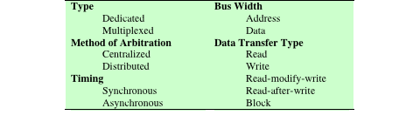
Elements of Bus Design
Below Comment
Notes:
Although a variety of different bus implementations exist, there are a few basic parameters or design elements that serve to classify and differentiate buses. Table 3.2 lists key elements.
Bus Types: Bus lines can be separated into two generic types: dedicated and multiplexed. A dedicated bus line is permanently assigned either to one function or to a physical subset of computer components. An example of functional dedication is the use of separate dedicated address and data lines, which is common on many buses. However, it is not essential. For example, address and data information may be transmitted over the same set of lines using an Address Valid control line. At the beginning of a data transfer, the address is placed on the bus and the Address Valid line is activated. At this point, each module has a specified period of time to copy the address and determine if it is the addressed module. The address is then removed from the bus, and the same bus connections are used for the subsequent read or write data transfer. This method of using the same lines for multiple purposes is known as time multiplexing.
The advantage of time multiplexing is the use of fewer lines, which saves space and, usually, cost. The disadvantage is that more complex circuitry is needed within each module. Also, there is a potential reduction in performance because certain events that share the same lines cannot take place in parallel.
Physical dedication refers to the use of multiple buses, each of which connects only a subset of modules. A typical example is the use of an I/O bus to interconnect all I/O modules; this bus is then connected to the main bus through some type of I/O adapter module. The potential advantage of physical dedication is high throughput, because there is less bus contention. A disadvantage is the increased size and cost of the system.
Method of arbitration: In all but the simplest systems, more than one module may need control of the bus. For example, an I/O module may need to read or write directly to memory, without sending the data to the processor. Because only one unit
at a time can successfully transmit over the bus, some method of arbitration is needed. The various methods can be roughly classified as being either centralized arbitration or distributed arbitration. In a centralized scheme, a single hardware device, referred to as a bus controller or arbiter, is responsible for allocating time on the bus. The device may be a separate module or part of the processor. In a distributed scheme, there is no central controller. Rather, each module contains access control logic and
the modules act together to share the bus. With both methods of arbitration, the purpose is to designate one device, either the processor or an I/O module, as master. The master may then initiate a data transfer (e.g., read or write) with some other device, which acts as slave for this particular exchange.
Timing: Timing refers to the way in which events are coordinated on the bus. Buses use either synchronous timing or asynchronous timing.

Slide 32
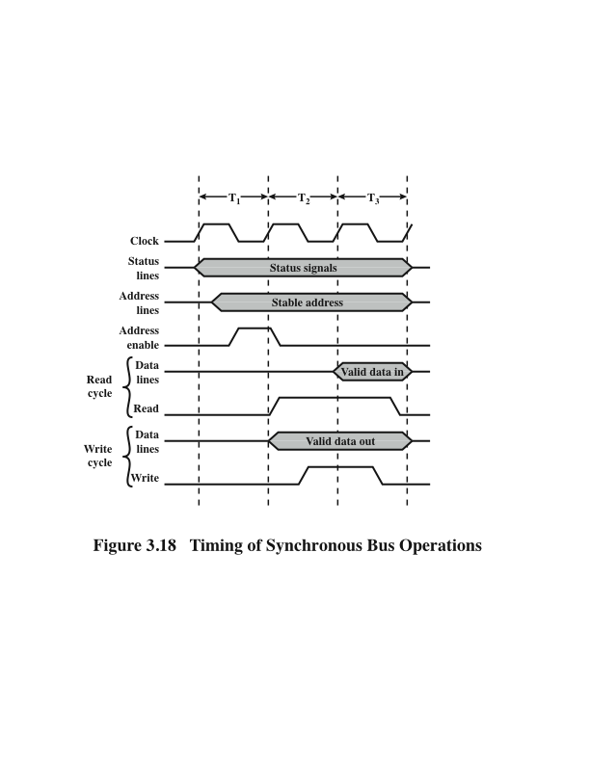
Timing of Synchronous Bus Operations DISCUSSED
Notes:
With synchronous timing, the occurrence of events on the bus is determined by a clock. The bus includes a clock line upon which a clock transmits a regular sequence of alternating 1s and 0s of equal duration. A single 1–0 transmission is referred to as a clock cycle or bus cycle and defines a time slot. All other devices on the bus can read the clock line, and all events start at the beginning of a clock cycle.
Figure 3.18 shows a typical, but simplified, timing diagram for synchronous read and write operations (see Appendix N for a description of timing diagrams). Other bus signals may change at the leading edge of the clock signal (with a slight reaction delay). Most events occupy a single clock cycle. In this simple example, the processor places a memory address on the address lines during the first clock cycle and may assert various status lines. Once the address lines have stabilized, the processor issues an address enable signal. For a read operation, the processor issues a read command at the start of the second cycle. A memory module recognizes the address and, after a delay of one cycle, places the data on the data lines. The processor reads the data from the data lines and drops the read signal. For a write operation, the processor puts the data on the data lines at the start of the second cycle and issues a write command after the data lines have stabilized. The memory module copies the information from the data lines during the third clock cycle.

Slide 33
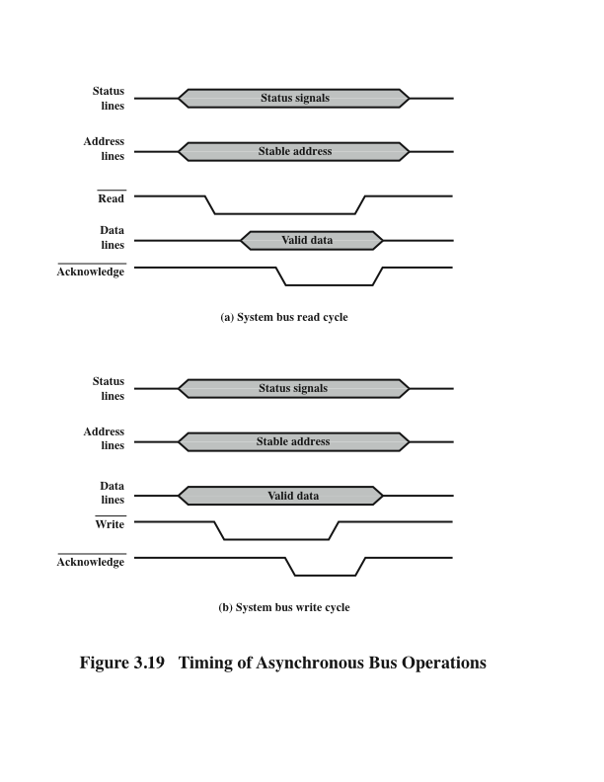
Timing of Asynchronous Bus Operations DISCUSSED
Notes:
With asynchronous timing, the occurrence of one event on a bus follows and depends on the occurrence of a previous event. In the simple read example of Figure 3.19a, the processor places address and status signals on the bus. After pausing for these signals to stabilize, it issues a read command, indicating the presence of valid address and control signals. The appropriate memory decodes the address and responds by placing the data on the data line. Once the data lines have stabilized, the memory module asserts the acknowledged line to signal the processor that the data are available. Once the master has read the data from the data lines, it deasserts the read signal. This causes the memory module to drop the data and acknowledge lines. Finally, once the acknowledge line is dropped, the master removes the address information.
Figure 3.19b shows a simple asynchronous write operation. In this case, the master places the data on the data line at the same time that it puts signals on the status and address lines. The memory module responds to the write command by copying the data from the data lines and then asserting the acknowledge line. The master then drops the write signal and the memory module drops the acknowledge signal.
Synchronous timing is simpler to implement and test. However, it is less flexible than asynchronous timing. Because all devices on a synchronous bus are tied to a fixed clock rate, the system cannot take advantage of advances in device performance. With asynchronous timing, a mixture of slow and fast devices, using older and newer technology, can share a bus.

Slide 34
Peripheral Component Interconnect (PCI)
Great feature of PCI Bus was that it was invented as an industry standard
PCI provides direct access to system memory for the devices that are connected to the bus which is then connected through a bridge that connects to the front side bus.
This configuration allowed for higher performance without slowing down the processor
Notes:
The peripheral component interconnect (PCI) is a popular high-bandwidth, processor independent bus that can function as a mezzanine or peripheral bus. Compared with other common bus specifications, PCI delivers better system performance for highspeed I/O subsystems (e.g., graphic display adapters, network interface controllers, and disk controllers).What makes PCI popular is very few chips to implement and support other bus attached to PCI bus. PCI is designed to support a variety of microprocessor based system.

Slide 35
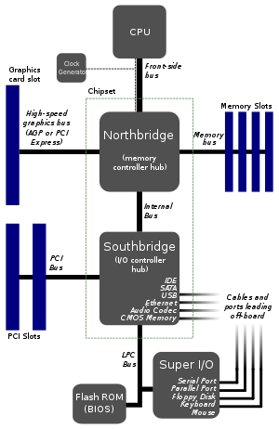
Peripheral Component Interconnect (PCI)
Notes:
This structure is a typical North-South Bridge chip structure based on PCI bus. CPU and Northbridge chip are connected via FSB (Front Side Bus). The Northbridge chip is mainly responsible for controlling data exchange between CPU and high-speed devices (AGP graphics card, memory).
Then, Southbridge is connected to Northbridge via an internal bus (like Hub-Link). The Southbridge chip is mainly responsible for data exchange of low-speed devices like floppy drive, hard disk, keyboard, and add-in card.
Where is PCI? It's under Southbridge. Under Southbridge, there are many buses: PCI, LPC (Low Pin Count), SATA, USB, etc. PCI bus is mainly responsible for connecting devices like network card, audio card, and SCSI card. LPC bus is mainly responsible for connecting common low-speed devices like BIOS, keyboard, mouse, floppy disk, etc.

Slide 36
PCI Bus Design
The PCI Bus was originally 33Mhz and then changed to 66Mhz.
PCI Bus became big with the release of Windows 95 with “Plug and Play” technology
“Plug and Play” utilized the PCI bus concept.
Notes:
Plug and Play, sometimes, abbreviated PnP, is a catchy phrase used to describe devices that work with a computer system as soon as they are connected. The user does not have to manually install drivers for the device or even tell the computer that a new device has been added. Instead the computer automatically recognizes the device, loads new drivers for the hardware if needed, and begins to work with the newly connected device.

Slide 37
Peripheral Component Interconnect (PCI)
Spec | Year | Change summary^{[15]}
PCI 1.0 | 1992 | Original issue
PCI 2.0 | 1993 | Incorporated connector and add-in card specification
PCI 2.1 | 1995 | Incorporated clarifications and added 66 MHz chapter
PCI 2.2 | 1998 | Incorporated ECNs, and improved readability
PCI 2.3 | 2002 | Incorporated ECNs, errata, and deleted 5 volt only keyed add-in cards
PCI 3.0 | 2004 | Removed support for 5.0 volt keyed system board connector
Notes:
ECN noun [countable] (electronic communications network) an electronic system
Errata are functional defects or errors, which may cause the PCI Compiler to deviate from published specifications. Documentation issues include errors, unclear descriptions, or omissions from current published specifications or product documents.

Slide 38
PCI System Bus Performance DISCUSSED
What makes the PCI bus one of the fastest I/O bus used today?
Three features make this possible:
Burst Mode: allows multiple sets of data to be sent
Full Bus Mastering: the ability of devices on the PCI bus to perform transfers directly
High Bandwidth Options: allows for increased speed of the PCI

Slide 39
Plug and Play
Requirements for full implementation:
Plug and Play BIOS
Extended System Configuration Data (ESCD)
Plug and Play operating system
Tasks it automates:
Interrupt Requests (IRQ)
Direct Memory Access (DMA)
Memory Addresses
Input / Output (I/O) Configuration
Notes:
Plug and Play refers to operating system functionality that supports connectivity, configuration and management

Slide 40
How PCI Works: Installing A New Device(Discussed)
Once a new device has been inserted into a PCI slot on the motherboard
1. Operating System Basic Input/Output System (BIOS) initiates Plug and Play (PnP) BIOS.
2. PnP BIOS scans the PCI bus for any new hardware connected to the bus. If new hardware is found, it will ask for identification.

Slide 41
How PCI Works: Installing A New Device
3.The device will respond with its identification and send its device ID to the BIOS through the bus.
4.PnP checks the Extended System Configuration Data (ESCD) to make sure the configuration data already exists for the card. (If the card is new, then there will be no data for it.)

Slide 42
How PCI Works: Installing A New Device
5. PnP will assign an Interrupt Request Line, Direct Memory Access, memory address and Input/Output settings to the card, then stores the information in the ESCD.
6. When the Windows software loads, it will check the PCI bus and the ESCD to see if there is new hardware. Windows will alert the user that new hardware has been found if there is new hardware installed and will also identify the hardware.

Slide 43
How PCI Works: Installing A New Device
7. Windows will determine the device and attempt to install its driver. The operating system may ask the user to insert a disk containing the driver or direct it to where the driver is located. In the event that Windows is unable to determine what the device is, it will provide a dialog window so the user can identify the hardware and load its driver.

Slide 44
How a Device Works
Example: PCI-based sound card
1.The sound card will convert the analog signal to a digital signal.
2.The digital audio data carried across the PCI bus to the bus controller, which determines which device on the PCI device has the priority to send data to the central processing unit (CPU) and whether the data will go directly to the CPU or to the system memory.
3.If the sound card is in recording mode, the bus controller will assign a high priority to the data coming from the sound card. It will send the sound cards data over the bus bridge to the system bus.
4.The system bus will save the data in system memory. When the recording is complete, then it will be up to the user to save the data from the sound card on either the hard drive, or will remain in memory for additional processing.

Slide 45
PCI: Present Requirements
Support multiple market segments
Backwards compatible
Scalable performance
Advanced features including QoS, power management, and data integrity

Slide 46
Peripheral Component Interconnect (PCI) Development
PCI Special Interest Group (SIG)
Created to develop further and maintain the compatibility of the PCI specifications
PCI Express (PCIe)
Point-to-point interconnect scheme intended to replace bus-based schemes such as PCI
Key requirement is high capacity to support the needs of higher data rate I/O devices, such as Gigabit Ethernet
Another requirement deals with the need to support time dependent data streams
Notes:
The peripheral component interconnect (PCI) is a popular high-bandwidth, processor independent bus that can function as a mezzanine or peripheral bus. Compared with other common bus specifications, PCI delivers better system performance for high speed
I/O subsystems (e.g., graphic display adapters, network interface controllers, and disk controllers).
Intel began work on PCI in 1990 for its Pentium-based systems. Intel soon released all the patents to the public domain and promoted the creation of an industry association, the PCI Special Interest Group (SIG), to develop further and maintain the compatibility of the PCI specifications. The result is that PCI has been widely adopted and is finding increasing use in personal computer, workstation, and server systems. Because the specification is in the public domain and is supported by a broad cross section of the microprocessor and peripheral industry, PCI products built by different vendors are compatible.
As with the system bus discussed in the preceding sections, the bus-based PCI scheme has not been able to keep pace with the data rate demands of attached devices. Accordingly, a new version, known as PCI Express (PCIe) has been developed. PCIe, as with QPI, is a point-to-point interconnect scheme intended to replace bus-based schemes such as PCI.
A key requirement for PCIe is high capacity to support the needs of higher data rate I/O devices, such as Gigabit Ethernet. Another requirement deals with the need to support time-dependent data streams. Applications such as video-on-demand and audio redistribution are putting real-time constraints on servers too. Many communications applications and embedded PC control systems also process data in real-time.
Today’s platforms must also deal with multiple concurrent transfers at ever-increasing data rates. It is no longer acceptable to treat all data as equal—it is more important, for example, to process streaming data first since late real-time data is as useless as no
data. Data needs to be tagged so that an I/O system can prioritize its flow throughout the platform.

Slide 47
PCI Express Solution

Slide 48
Advanced Switching with PCI express(Discussed)
Signals take place at link level
Allows for QoS and fan out capabilities
Utilizes system bandwidth
Notes:
In digital electronics, the fan-out is the number of gate inputs driven by the output of another single logic gate. The maximum fan-out of an output measures its load-driving capability: it is the greatest number of inputs of gates of the same type to which the output can be safely connected.

Slide 49
Point-to-Point Interconnect(for core to core connection)->Bus system’s Bottleneck
Principal reason for change was the electrical constraints encountered with increasing the frequency of wide synchronous buses
At higher and higher data rates it becomes increasingly difficult to perform the synchronization and arbitration functions in a timely fashion
A conventional shared bus on the same chip magnified the difficulties of increasing bus data rate and reducing bus latency to keep up with the processors
Has lower latency, higher data rate, and better scalability
Notes:
The shared bus architecture was the standard approach to interconnection between the processor and other components (memory, I/O, and so on) for decades. But contemporary systems increasingly rely on point-to-point interconnection rather than shared buses.
The principal reason driving the change from bus to point-to-point interconnect was the electrical constraints encountered with increasing the frequency of wide synchronous buses. At higher and higher data rates, it becomes increasingly difficult
to perform the synchronization and arbitration functions in a timely fashion. Further, with the advent of multi-core chips, with multiple processors and significant memory on a single chip, it was found that the use of a conventional shared bus on the same
chip magnified the difficulties of increasing bus data rate and reducing bus latency to keep up interconnect has lower latency, higher data rate, and better scalability.

Slide 50
Quick Path Interconnect new standard
QPI
Introduced in 2008
Multiple direct connections
Direct pairwise connections to other components eliminating the need for arbitration found in shared transmission systems
Layered protocol architecture
These processor level interconnects use a layered protocol architecture rather than the simple use of control signals found in shared bus arrangements
Packetized data transfer
Data are sent as a sequence of packets each of which includes control headers and error control codes
Notes:
In this section, we look at an important and representative example of the point-to-point interconnect approach: Intel’s QuickPath Interconnect (QPI), which was introduced in 2008.
The following are significant characteristics of QPI and other point-to-point interconnect schemes:
• Multiple direct connections: Multiple components within the system enjoy direct pairwise connections to other components. This eliminates the need for arbitration found in shared transmission systems.
• Layered protocol architecture: As found in network environments, such as TCP/IP-based data networks, these processor-level interconnects use a layered protocol architecture, rather than the simple use of control signals found in shared bus arrangements.
• Packetized data transfer: Data are not sent as a raw bit stream. Rather, data are sent as a sequence of packets, each of which includes control headers and error control codes.

Slide 51
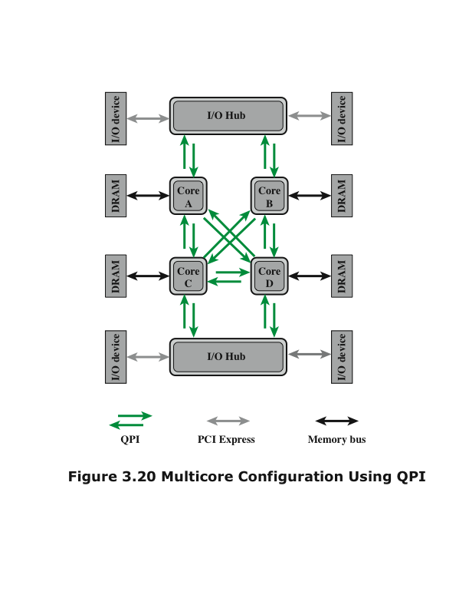
Multicore Configuration Using QPI
Notes:
Figure 3.20 illustrates a typical use of QPI on a multi-core computer. The QPI links (indicated by the green arrow pairs in the figure) form a switching fabric that enables data to move throughout the network. Direct QPI connections can be established between each pair of core processors. If core A in Figure 3.20 needs to access the memory controller in core D, it sends its request through either cores B or C, which must in turn forward that request on to the memory controller in core D. Similarly, larger systems with eight or more processors can be built using processors with three links and routing traffic through intermediate processors.
In addition, QPI is used to connect to an I/O module, called an I/O hub (IOH). The IOH acts as a switch directing traffic to and from I/O devices. Typically in newer systems, the link from the IOH to the I/O device controller uses an interconnect technology called PCI Express (PCIe), described later in this chapter. The IOH translates between the QPI protocols and formats and the PCIe protocols and formats. A core also links to a main memory module (typically the memory uses dynamic access random memory (DRAM) technology) using a dedicated memory bus.

Slide 52
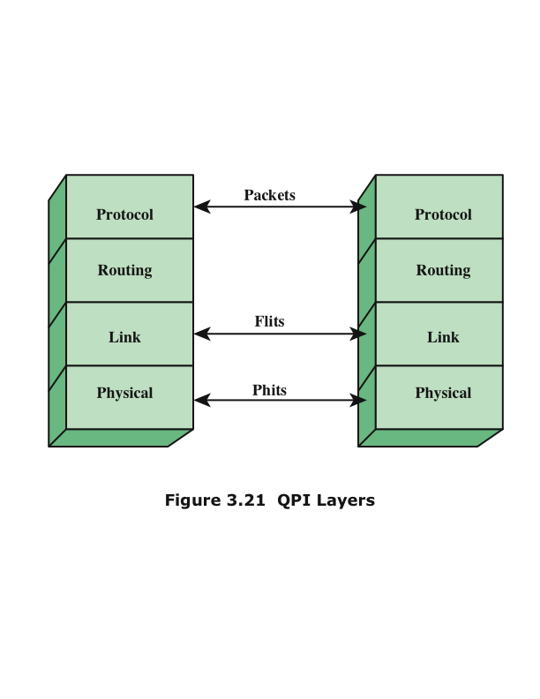
QPI Layers
Notes:
QPI is defined as a four-layer protocol architecture, encompassing the following layers (Figure 3.21):
• Physical: Consists of the actual wires carrying the signals, as well as circuitry and logic to support ancillary features required in the transmission and receipt of the 1s and 0s. The unit of transfer at the Physical layer is 20 bits, which is called a Phit (physical unit).
Link: Responsible for reliable transmission and flow control. The Link layer’s unit of transfer is an 80-bit Flit (flow control unit).
• Routing: Provides the framework for directing packets through the fabric.
• Protocol: The high-level set of rules for exchanging packets of data between devices. A packet is comprised of an integral number of Flits.
(https://en.wikipedia.org/wiki/Intel_QuickPath_Interconnect)

Slide 53
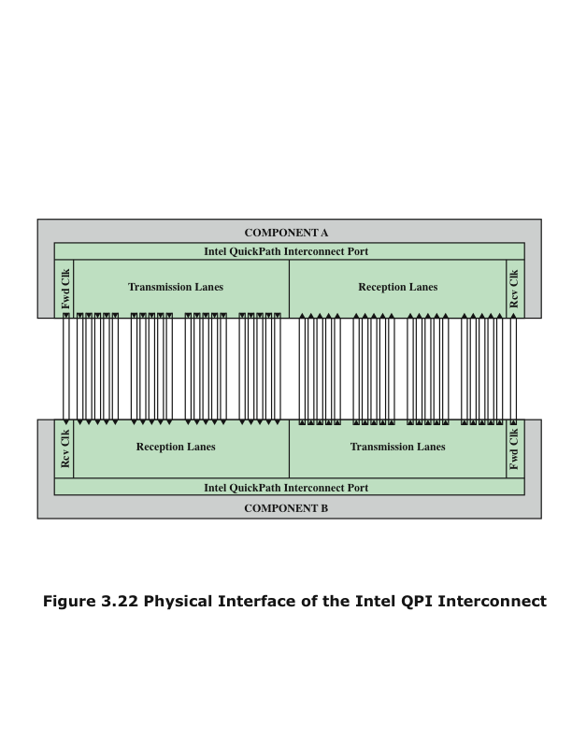
Physical Interface of the Intel QPI Interconnect
Differential signaling, or Balanced transmission.
Low-voltage differential signaling (LVDS).
Notes:
Figure 3.22 shows the physical architecture of a QPI port. The QPI port consists of 84 individual links grouped as follows. Each data path consists of a pair of wires that transmits data one bit at a time; the pair is referred to as a lane. There are 20 data lanes
in each direction (transmit and receive), plus a clock lane in each direction. Thus, QPI is capable of transmitting 20 bits in parallel in each direction. The 20-bit unit is referred to as a phit. Typical signaling speeds of the link in current products calls for operation
at 6.4 GT/s (transfers per second). At 20 bits per transfer, that adds up to 16 GB/s, and since QPI links involve dedicated bidirectional pairs, the total capacity is 32 GB/s.
The lanes in each direction are grouped into four quadrants of 5 lanes each. In some applications, the link can also operate at half or quarter widths in order to reduce power consumption or work around failures.
The form of transmission on each lane is known as differential signaling, or balanced transmission. With balanced transmission, signals are transmitted as a current that travels down one conductor and returns on the other. The binary value depends on the voltage difference. Typically, one line has a positive voltage value and the other line has zero voltage, and one line is associated with binary 1 and one line is associated with binary 0. Specifically, the technique used by QPI is known as low-voltage differential signaling (LVDS). In a typical implementation, the transmitter injects a small current into one wire or the other, depending on the logic level to
be sent. The current passes through a resistor at the receiving end, and then returns in the opposite direction along the other wire. The receiver senses the polarity of the voltage across the resistor to determine the logic level.

Slide 54
QPI Link Layer
Flow control function
Needed to ensure that a sending QPI entity does not overwhelm a receiving QPI entity by sending data faster than the receiver can process the data and clear buffers for more incoming data
Performs two key functions: flow control and error control
Operate on the level of the flit (flow control unit)
Each flit consists of a 72-bit message payload and an 8-bit error control code called a cyclic redundancy check (CRC)
Error control function
Detects and recovers from bit errors, and so isolates higher layers from experiencing bit errors
Notes:
The QPI link layer performs two key functions: flow control and error control. These functions are performed as part of the QPI link layer protocol, and operate on the level of the flit (flow control unit). Each flit consists of a 72-bit message payload and an 8-bit error control code called a cyclic redundancy check (CRC). We discuss error control codes in Chapter 5.
A flit payload may consist of data or message information. The data flits transfer the actual bits of data between cores or between a core and an IOH. The message flits are used for such functions as flow control, error control, and cache coherence. We discuss cache coherence in Chapters 5 and 17.
The flow control function is needed to ensure that a sending QPI entity does not overwhelm a receiving QPI entity by sending data faster than the receiver can process the data and clear buffers for more incoming data. To control the flow of data, QPI makes use of a credit scheme. During initialization, a sender is given a set number of credits to send flits to a receiver. Whenever a flit is sent to the receiver, the sender decrements its credit counters by one credit. Whenever a buffer is freed at the receiver, a credit is returned to the sender for that buffer. Thus, the receiver controls that pace at which data is transmitted over a QPI link.
Occasionally, a bit transmitted at the physical layer is changed during transmission, due to noise or some other phenomenon. The error control function at the link layer detects and recovers from such bit errors, and so isolates higher layers from experiencing bit errors. The procedure works as follows for a flow of data from system A to system B:
1. As mentioned, each 80-bit flit includes an 8-bit CRC field. The CRC is a function of the value of the remaining 72 bits. On transmission, A calculates a CRC value for each flit and inserts that value into the flit.
2. When a flit is received, B calculates a CRC value for the 72-bit payload and compares this value with the value of the incoming CRC value in the flit. If the two CRC values do not match, an error has been detected.
3. When B detects an error, it sends a request to A to retransmit the flit that is in error. However, because A may have had sufficient credit to send a stream of flits, so that additional flits have been transmitted after the flit in error and before A receives the request to retransmit. Therefore, the request is for A to back up and retransmit the damaged flit plus all subsequent flits.

Slide 55
QPI Routing and Protocol Layers
Routing Layer
Protocol Layer
Used to determine the course that a packet will traverse across the available system interconnects
Defined by firmware and describe the possible paths that a packet can follow
Packet is defined as the unit of transfer
One key function performed at this level is a cache coherency protocol which deals with making sure that main memory values held in multiple caches are consistent
A typical data packet payload is a block of data being sent to or from a cache
Notes:
The Routing layer is used to determine the course that a packet will traverse across the available system interconnects. Routing tables are defined by firmware and describe the possible paths that a packet can follow. In small configurations, such as a two-socket platform, the routing options are limited and the routing tables quite simple. For larger systems, the routing table options are more complex, giving the flexibility of routing and rerouting traffic depending on how (1) devices are populated in the platform, (2) system resources are partitioned, and (3) reliability events result in mapping around a failing resource.
In this layer, the packet is defined as the unit of transfer. The packet contents definition is standardized with some flexibility allowed to meet differing market segment requirements. One key function performed at this level is a cache coherency protocol, which deals with making sure that main memory values held in multiple caches are consistent. A typical data packet payload is a block of data
being sent to or from a cache.

Slide 56
?

